Slide 1

SMART INDIA HACKATHON 2026
SECURE MESH
Problem Statement ID – 26223
Problem Statement Title- Student innovation –
Disaster Management includes ideas related to
risk mitigation, Planning and management
before ,after or during a disaster.
Theme- Disaster Management
PS Category- Hardware
Team Name- Outlaws

Slide 2





Secure Mesh- Private, Offline, Trusted, Intelligent
OUTLAWS
Proposed Solution
OFFLINE FIRST
DECENTRALIZED MESH
ZERO-TRUST SECURITY
LOCAL & GROUNDED AI
📴
🛡
🧠
Local Sync
Communicates, stores, and syncs all data locally
Zero Cloud
Fully functional with no cloud dependency
Peer Discovery
mDNS + QUIC + Ed25519 authentication
Signed Event Log
Append-only, origin sequence order
Explicit Auth
Authenticated before any peer exchange
Rust Enforced
Trust state checked on every message
On-Device
Qwen2.5-1.5B + BGE embeddings via llama.cpp
Citations
Answers grounded in local data (0/19 → 19/19)
Works even with no visible peers
Built for availability under partition
Authentication alone grants nothing
Grounded answers. No guessing.
✅ PROOF, NOT PITCH
🧪 759 Automated Tests
🖥 Working Tauri Desktop App
🚩 6 Phases Shipped

Slide 3
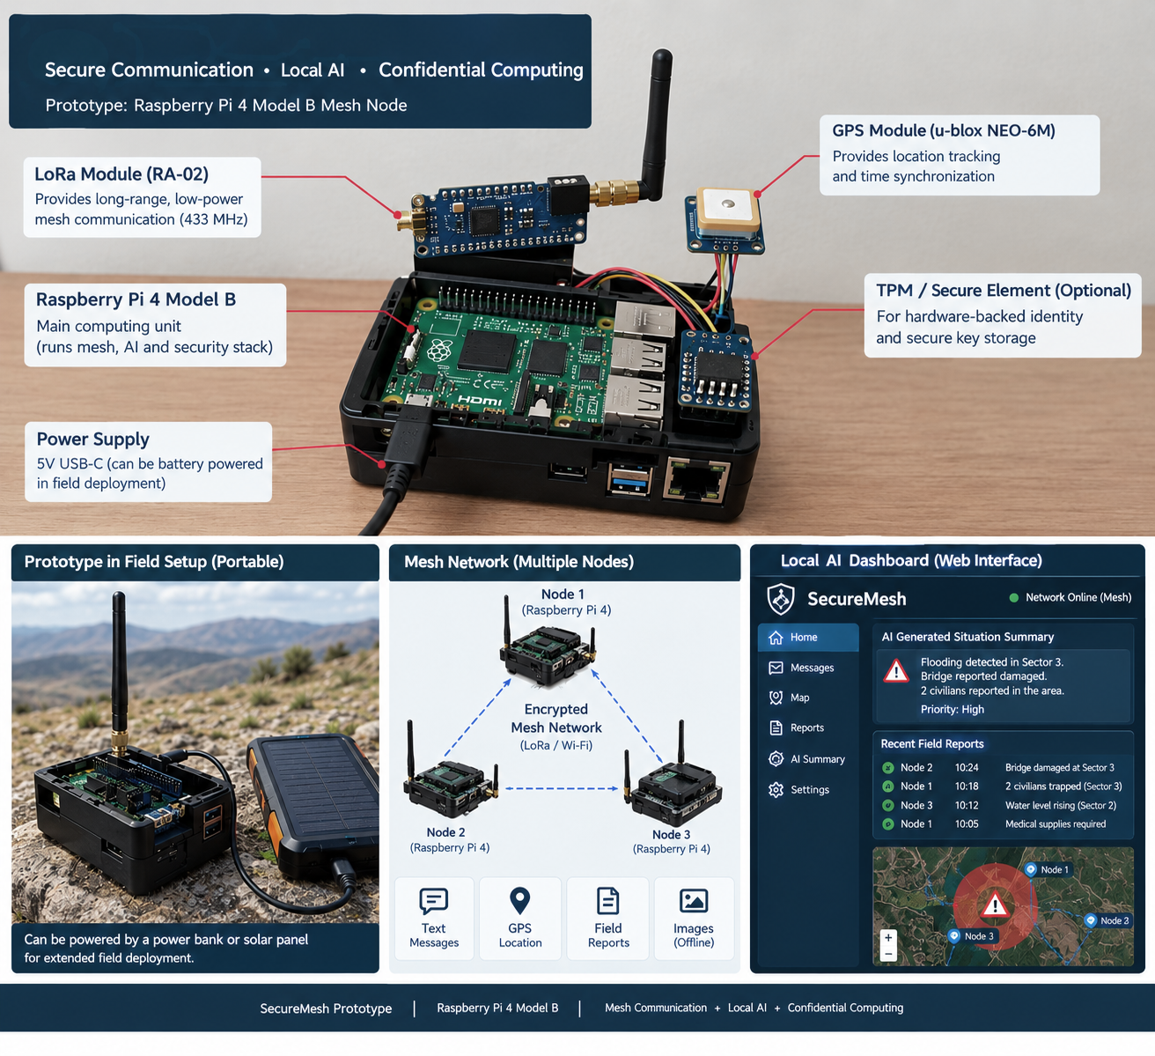
TECHNICAL APPROACH
OUTLAWS
🌐 MESH NETWORK TOPOLOGY
❖ TECH STACK
🔒 Encrypted via libp2p + QUIC · mDNS discovery
🖥
FRONTEND & APP SHELL
Node 1
Raspberry Pi 4
Tauri 2
React 19
TypeScript
Vite 7
⚙
Cross-platform desktop UI, typed end-to-end
🦀
CORE & STORAGE
⚙
Node 2
Raspberry Pi 4
⚙
Node 3
Raspberry Pi 4
Rust
SQLite
Layered, testable Rust core; file-backed persistence
Each node runs the full mesh + AI stack independently — no central server
🌐
MESH NETWORKING
🖥 NODE HARDWARE
libp2p
QUIC
mDNS
Ed25519
Encrypted P2P transport, local discovery, signed identity
💻
Raspberry Pi 4 Model B
Main compute — runs the mesh, AI inference, and security stack
🧠
LOCAL AI
🔌
Power Supply
5V USB-C, battery-capable for field deployment
Qwen2.5-1.5B (fine-tuned)
llama.cpp
BGE embeddings
💾
QLoRA
Storage
microSD / eMMC for the local database and model files
On-device inference, GGUF Q4_K_M, zero cloud calls
📶
Networking
Onboard Wi-Fi / Ethernet — libp2p + QUIC, mDNS discovery

Slide 4
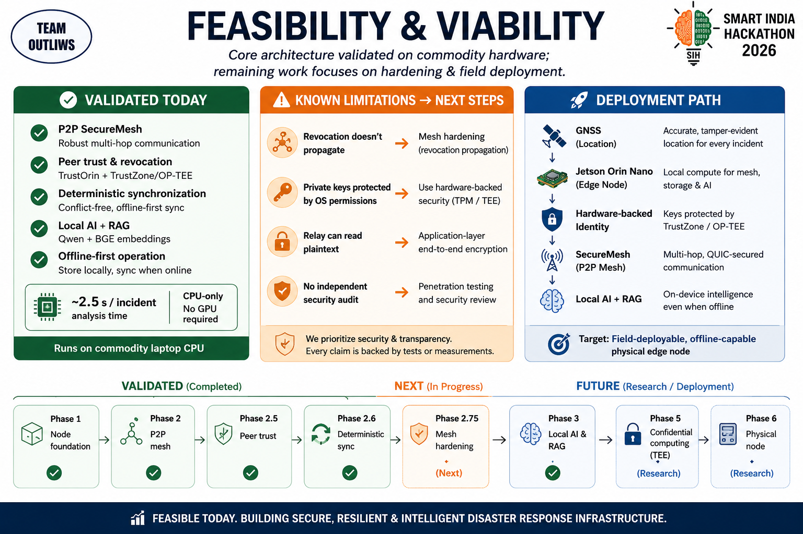
FEASIBILITY AND VIABILITY
OUTLAWS
💻
Laptop Node
Fine-tuned SecureMesh-SLM
⚙
Pi / Jetson Node
Production model
🔒 libp2p + QUIC · mDNS discovery
Independent AI models per node — mesh protocol and record format unaffected
✓ VALIDATED TODAY
⚠ KNOWN LIMITATIONS → NEXT STEPS
🌐
P2P Mesh Networking
libp2p + QUIC transport, mDNS discovery, multi-hop relay
📡
Revocation does not propagate mesh-wide
→ mesh-wide revocation propagation
🛡
Peer Identity & Trust
Ed25519 node identity; peers explicitly enrolled by an operator
🔑
Private keys secured by OS permissions only
→ hardware-backed keys (TPM / TEE)
🔄
Deterministic Synchronization
Conflict-free, offline-first sync over a signed event log
🔓
Relay nodes can read forwarded plaintext
→ application-layer end-to-end encryption
🧠
Local AI + RAG
Fine-tuned Qwen2.5-1.5B on-device, with BGE embeddings for retrieval
📴
🔍
No independent security audit yet
→ penetration testing and review
Offline-First Operation
Full incident capture and sync with zero connectivity
~2.5s / analysis │ 759 tests, 0 failed
Every claim on this slide is backed by an automated test or a measurement.
Measured on x86-64 CPU — Raspberry Pi / Jetson benchmarking in progress

Slide 5
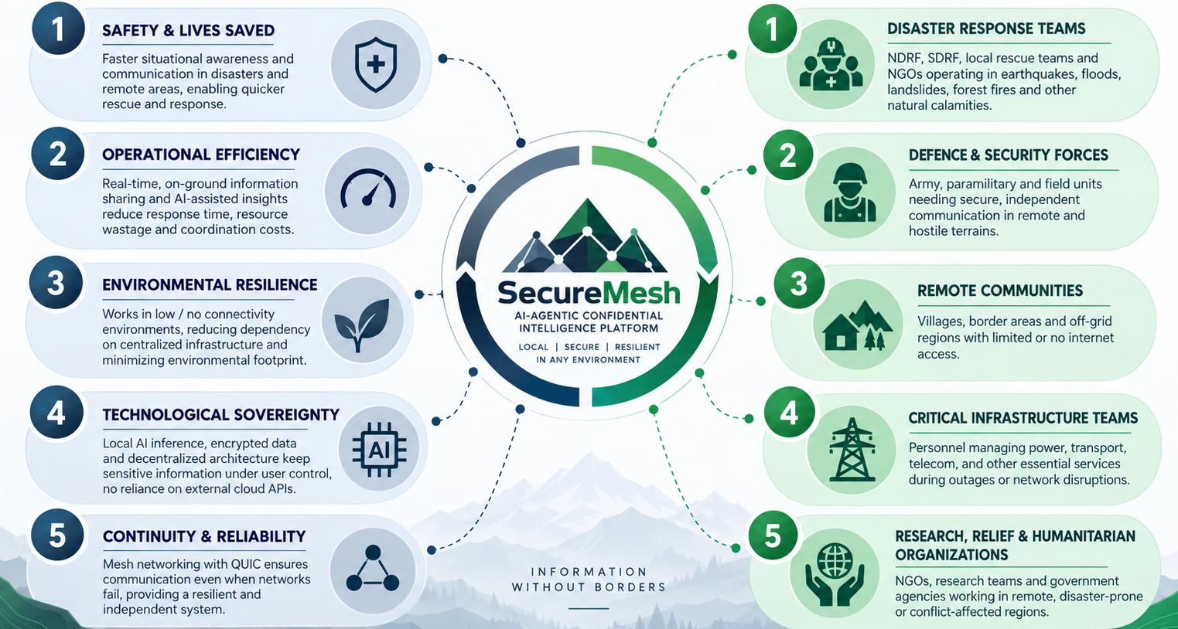
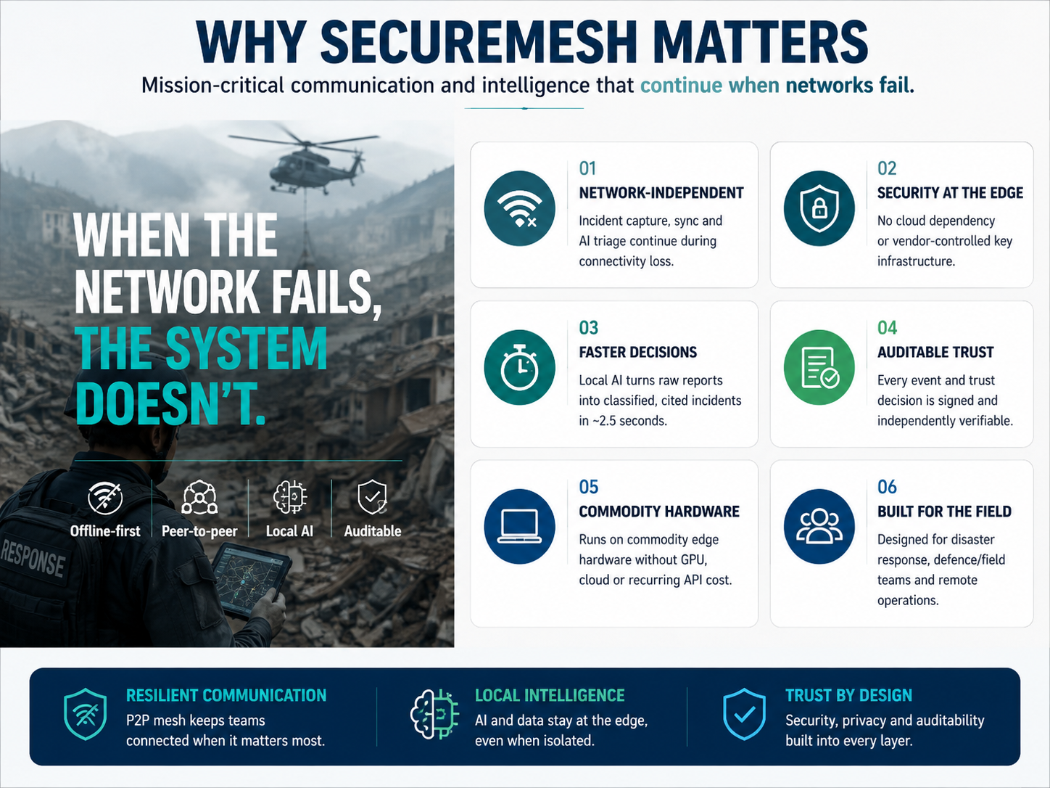
IMPACT AND BENEFITS
OUTLAWS

Slide 6







RESEARCH & REFERENCES
OUTLAWS
Built on trusted open-source technologies and standards.
Project Repository: github.com/Rengoku9000/Secure-Mesh-V1
Source code, documentation, tests and measured benchmarks.
Qwen2.5-1.5B-Instruct: huggingface.co/Qwen/Qwen2.5-1.5B-Instruct-GGUF (Apache-2.0)
Local LLM used for on-device inference; fine-tuned into SecureMesh-SLM.
BGE-small-en-v1.5: huggingface.co/CompendiumLabs/bge-small-en-v1.5-gguf (MIT)
Embeddings model for local semantic retrieval.
llama.cpp: github.com/ggml-org/llama.cpp (MIT)
CPU inference runtime used for local LLM execution.
libp2p: libp2p.io
Peer-to-peer networking stack (QUIC transport, mDNS discovery).
NVIDIA Jetson Linux Developer Guide: docs.nvidia.com/jetson
OP-TEE, Secure Boot, Firmware TPM guidance.
OP-TEE: optee.readthedocs.io
Open-source TrustZone trusted execution environment.

